Slide 1
MEDICAL ETHICS
Professor Quazi Tarikul Islam

Slide 2
Hippocrates, Father of Medicine (460-370 BC)

Slide 4
Aristotle, Father of Ethics (382-322 BC)

Slide 5
Medical Ethics
The four principles approach to biomedical ethics' (autonomy, beneficence, non-maleficence and justice, collectively known as the "principlesoriented framework" or "principlism") has been developed by Beauchamp and Childress in America since the 1970s.
It has been promoted by Raanan Gillon as the "four principles plus scope"2 approach in Europe. It has been popularly accepted, especially in medical circles, as a set of "universal" guidelines for bioethics, despite much vehement criticism.

Slide 11
Morality and ethics The terms moral and ethics come from Latin and Greek, respectively (mores and ethos), deriving their meaning from the idea of “custom”. There is also another Greek word ēthos which denotes a character feature. Aristotle called his ethics a study of character traits, in sense of virtues and vices.

Slide 12
Ethics and Moral
According to this understanding, “ethics” leans towards decisions based upon individual character, and the more subjective understanding of right and wrong by individuals – whereas “morals” emphasises the widely-shared communal or societal norms about right and wrong

Slide 13
Clinical Ethics Principles
Based on four common, basic prima facie moral commitments:
1. Autonomy- Respect patient’s decision about their own health
2. Beneficence- Principle of doing good/ Promote patients best interest
3. Non-maleficence- Principle of doing no harm
4. Justice- Distribute medical benefits fairly
Journal of Medical Ethics 1 999;25:3 15-321

Slide 14
Autonomy
Doctor-Patient Relationship
Respect for Person/Patient
Below 18 years/Mentally incapacitated/ unconscious
Patient’s right to refuse therapy
Doctor should provide adequate information to patient
Truth –Telling
Informed Consent
Confidentiality

Slide 15
Truth Telling
Much Wisdom- Much Grief
Increase Knowledge – Increase Sorrow

Slide 16
Autonomy
Freedom of thought Freedom of will Freedom of action

Slide 17
Autonomy
Respect patients as individuals (e.g., respecting their privacy by maintaining confidentiality and being truthful about their medical care).
Provide the information and opportunity for patients to make their own decisions regarding their care (e.g., informed consent).
Honor and respect patients' decisions regarding their choice to accept or decline care.
In addition to having the right to refuse a diagnostic or therapeutic intervention, patients also have the right to refuse to receive information

Slide 18
Beneficience
Do good for patient
Consider patient’s view and medical view
Conflict
Health of my patient will be my first consideration
Geneva Declaration

Slide 19
Beneficience
It requires that the procedure be provided with the intent of doing good for the patient involved. Demands that health care providers develop and maintain skills and knowledge, continually update training, consider individual circumstances of all patients, and strive for net benefit.
Act in the best interest of the patient and advocate for the patient.
May conflict with autonomy

Slide 20
Non- Maleficience
Do no harm
Benefit versus Risk
Share information with patient
Informed decision

Slide 21
Non- Maleficience
It requires that a procedure does not harm the patient involved or others in society.
Infertility specialists operate under the assumption that they are doing no harm or at least minimizing harm by pursuing the greater good.
Reproductive technologies have limited success rates, the emotional state of the patient may be impacted negatively. In some cases, it is difficult for doctors to successfully apply the “do no harm principle”.
Avoid causing injury or suffering to patients
May conflict with beneficence

Slide 22
Justice
Proper medical care ( Fair/Even handed)
Respect for needs of the individual
Respect for right of a person (economic, social , educational & racial)
Respect for merit: financial, political, social
Treat patients fairly and equitably.
Equity is not the same as equality.

Slide 23
JUSTICE:
The idea that the burdens and benefits of new or experimental treatments must be distributed equally among all groups in society.
Requires that procedures uphold the spirit of existing laws and are fair to all players involved. The health care provider must consider four main areas when evaluating justice:
fair distribution of scarce resources,
competing needs,
rights and obligations, and
potential conflicts with established legislation.
.

Slide 25
Example
NG feeding in post CVD semi conscious patient
Autonomy: The patient wishes to be feed or not
Beneficience and Non-maleficience :
Feeding may improve nutritional status and aid recovery.
Risk of complication from insertion of NG tube to Aspiration.
Justice : Heavy resource burden looking after NG feeding patient in Hospital

Slide 26
Confidentiality
Confidentiality is a implied contract necessary for doctor patient relationship.
Without it patient’s autonomy and privacy is compromised.
Trust is lost and relationship weakend

Slide 27
When to breach Confidentiality
Notifiable diseases
Drug addiction
Abortion
IVF
Organ transplant
Birth and deaths
Police/Court -- request/Order
Apprehension or prosecution of terrorists

Slide 28
Negligence
This is the commonest reason for a Doctor to go to Court.
Breach of appropriate standard care: The doctor is not negligent if he or she acted in accordance with a responsible / reasonable/ respectable body of medical opinion.
Breach of the duty of care caused harm

Slide 29
Modern Ethics in Current Use
Today, the principles and values of medical ethics have achieved a great deal of acceptance within the medical community. The field can be roughly divided into four areas:
hospital ethics,
ethics at private practices,
clinical research ethics,
ethics in public health.

Slide 30
Hospital Ethics
Much of modern ethics concerns itself with inpatient matters. Many of the most pressing ethical issues, such as withdrawal of treatment for dying patients and informed consent for procedures, primarily take place in the hospital.
This is why almost every large hospital today has an ethics committee, but hospital ethics committees are a relatively new phenomenon.

Slide 31
Ethics in Private Practices
Whereas physicians in hospitals face high-profile issues, such as end-of-life decisions or the use of novel experimental treatments, private practices face such issues as cultural sensitivity, professional responsibility, distribution of resources, and time constraints on appointments.

Slide 32
Clinical Research Ethics
Obtaining informed consent from research participants is the single greatest ethical issue in medical research. Investigators are asking participants to take a risk, primarily to benefit someone else.
Potential participants sign up often because they think they're going to get a new cure—even though they will often see little or no benefit, at least in early trials.

Slide 33
Clinical research is a closely monitored activity. The organization doing the research is required to set up an institutional review board (IRB), a group of peers who are not supposed to benefit financially if the study is successful. ( Conflict of Interest)
Informed consent documents must thoroughly describe the risks and benefits, but they can't be so long that research participants can't easily read through them, and they can't use terms that the participants don't understand

Slide 34
Ethics in Public Health
A great deal of medical ethics has to do with public health. This is territory riven with ethical pitfalls, involving such issues as preventing disease, prolonging life, and promoting health through organized efforts
Public health authorities deal with such problems as flu epidemics, drug abuse, providing mental health services, monitoring children for health issues at birth, and the cost of healthcare.

Slide 36
principles incorporate the characteristics and values that most people associate with ethical behavior.
HONESTY. ...
INTEGRITY. ...
PROMISE-KEEPING & TRUSTWORTHINESS. ...
LOYALTY. ...
FAIRNESS. ...
CONCERN FOR OTHERS. ...
RESPECT FOR OTHERS. ...
LAW ABIDING.

Slide 37
Case- 1
A 30- year-old bank officer presented to physician with fever for 6 weeks and weight loss. There was no cough. Routine investigations and CXR were indecisive. She has been asked to do further tests as because there was bilateral hilar lymphadenopathy. Patient become gloomy as she went on searching Google about her present situation. She had been asked for mediastinal LN biopsy. Unfortunately histopathology and immune histocyto chemistry confimed as Hodgekin’s Lymphoma.

Slide 38
Patient’s Thoughts/ Concern
Is this cancer?
If so How long I can live with this.
Is there any best opted treatment ?
Can it affect my fiancee ?
My Aunt died of cancer. She had so much pain doctor could not able to do anything to help.

Slide 39
Breaking Bad News
Conduct of Interview
Exploration and problem negotiation
Communication, Ethics and Law

Slide 40
Conduct of Interview
Introduce yourself to patient
Room should be quiet and comfortable. Allow parents / partner
How are you after biopsy ?
Whether she knows about the Dx
Tell her the Dx and give a pause.(Truth telling)
Ask her if she knows about HL and wait for response

Slide 41
When timing is right acknowledge that it must be a big shock for her
Reassure that there are specialist where well established treatments available
She may believe that having cancer means dying in agony so it is important to dispel the myths ( Concern)
Tell her that you will refer her to haemato-oncologist for proper treatment
At all times allow her to make her own comments
Listen empathetically to all her concern

Slide 42
Exploration and problem negotiation
Make a good rapport with the patient
Tell clearly the biopsy report with compassion and check her understanding
Give time to absorb the news and to ask question to you
Tell her what will happen next
Give as much information as she feels able to cope even in writings.

Slide 43
Communication, Ethics and Law
Make sure that you are not breaking bad news to a wrong person. (autonomy/cofidentiality)
If you are not the right person to treat refer to a relevant specialist( Law)
Keep in mind followings could be the reactions from the patient
a. Immediate: Numb/Denial
Are you sure about the Dx?
This may be a wrong report

Slide 44
As a doctor you should have sufficient emotional and professional maturity.
b. Gradual and late: patient may be angry with the doctor, sadness, acceptance, eventually cope & hope with the time

Slide 45
Common mistakes made by doctor
Irrelevant discussion
Body languages
When to be silent
Too much information
Conveying impending doom
Comment on survival time

Slide 46
Above all, the purpose of medical ethics is to protect and defend human dignity and patients' rights.
Medical ethics is not about avoiding harm; rather, it is a set of norms, values and principles. These norms, values and principles are intended to govern medical ethical conduct

Slide 47
Case -2
Mr. X 82-year-old elderly man who suffered from massive ishaemic stroke 3 years ago has been bed bound since then. Recently he got admitted with severe aspiration Pneumonia and UTI. His GCS is 11/15. He has vascular dementia with IHD,DM and HTN. He has history of Ca prostate treated 15 years ago. He is on NG tube antibiotics with other medications. There is no much improvement in last 5 days.
Consultant feels it is appropriate to sign
“Do Not Attempt Resuscitation” (DNAR) form for her should he deteriorate.

Slide 48
Conduct of Interview
Introduce yourself to patient
Room should be quiet and comfortable. Allow parents / partner
Whether she knows about the Dx
Tell her the Dx and give a pause.(Truth telling)
Ask her if she knows about multi morbid condition and wait for response

Slide 49
When timing is right acknowledge that it must be a big shock for her
Tell the daughter, showing empathy “ I am very sorry that your mother is not very well. Give a pause.
There is little chance to recover from this stage of illness (concern)
Ask her is she has spoken to other family members.
Cautiously use the word “Death”
Resuscitation at this point will not be of any use (Truth telling)
At all times allow her to make her own comments
Listen empathetically to all her concern

Slide 50
Exploration and problem negotiation
Make a good rapport with the patient
Tell clearly the current situation of the patient with compassion and check her understanding
Give time to absorb the news and to ask question to you.
Tell her that current medical status of patient has indication for DNAR relevant to patient.
Give as much information as she feel able to cope even in writings.

Slide 51
Communication, Ethics and Law
Make sure that you are not breaking bad news to a wrong person. (autonomy/cofidentiality)
If she seeks to arrange a medical board with other consultants for the treatment of her patient( Law)
Keep in mind followings could be the reactions from the patient
a. Immediate: Numb/Denial
Are you sure about the Dx?
There may be chances to recover

Slide 52
As a doctor you should have sufficient emotional and professional maturity.
b. Gradual and late: patient may be angry with the doctor, sadness, acceptance, eventually hope with the time.
Reassure her DNAR decision is not final is reviewed by team on regular basis

Slide 53
END OF LIFE

Slide 54
End of Life decisions
This is a contentious area and medical opinion is diverse
The view that whenever possible human life should be maintained, could be argued as ethically unjustified if extending that life results in suffering(non-maleficiance).
If trivial life extension occurs at enormous monetary expense (Justice)

Slide 55
End of Life decisions
Killing VS letting die
Withholding VS withdrawing treatment
DNR
Euthanasia
Who will give decision ?

Slide 56
When to discuss palliative care :
Patient imminently dying
Significant suffering and poor prognosis
Significant sufferings regardless of prognosis
Patient who fear future pain and suffering
All patients with possibly life-threatening illness.

Slide 57
Criteria are as follows
Patient likely to require endotracheal intubation and invasive mechanical ventilator support.
Patients requiring support of two or more organ systems (inotropes and haemofiltration).
Patients with chronic impairment of one or more organ system ( eg- COPD or severe Ischaemic heart disease ) who require support for acute reversible failure of another organ.

Slide 58
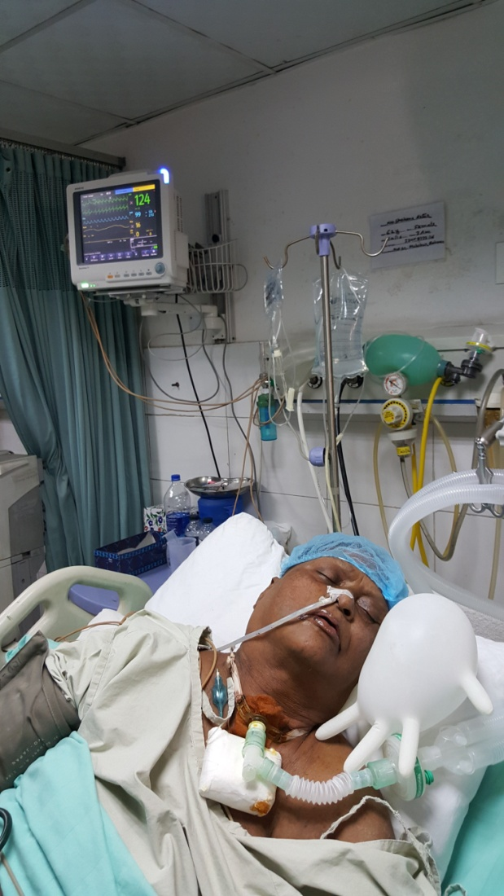
They are this kind of unfortunate patients

Slide 59
Euthanasia / Physician Assisted Suicide
Euthanasia also known as assisted suicide or physician / doctor-assisted suicide, and more loosely termed mercy killing, means to take a deliberate action with the express intention of ending a life to relieve intractable (persistent, unstoppable) suffering.

Slide 60
Euthanasia / Physician Assisted Suicide
In the majority of countries euthanasia or assisted suicide is against the law.
According to the National Health Service (NHS), UK, it is illegal to help somebody kill themselves, regardless of circumstances.
Assisted suicide, or voluntary euthanasia carries a maximum sentence of 14 years in prison in the UK, In the USA the law varies in some states.

Slide 61
Euthanasia / Physician Assisted Suicide
There are two main classification of euthanasia:
Voluntary euthanasia- this is the euthanasia conducted with consent. Since 2009 voluntary euthanasia has been legal in Belgium, Luxembourg, Netherlands, Switzerland, and the state of Oregon (USA) and Washington (USA).

Slide 62
Euthanasia / Physician Assisted Suicide
Involuntary euthanasia :
Euthanasia is conducted without consent. The decision is made by another person because the patient is incapable of giving proper informed consent.

Slide 63
Patient/relatives /Surrogate can sign DNI/DNR if he/she/they do not want resuscitation.

Slide 64
Places where counseling done as well as family care given :

Slide 65
GMP

Slide 66
Duties of a Doctor
Please apply ethical principles to the above lists as described in “Good Medical Practice”

Slide 67
BCPS

Slide 68
Ethics in Medicine (BCPS)
Topics
Difficult patient Encounters
End-of-Life Issues
Interdisciplinary Team Issues
Professionalism
Resource Allocation
Breaking Bad News
Confidentiality
Do not Resuscitate during Anesthesia and Urgent Procedures

Slide 69
Topics ( cont)
Physician-Patient Relationship
Spirituality and Medicine
Clinical Ethics and Law
Cross-cultural issues and Diverse Beliefs
Do not Resuscitate Orders
Informed Consent
Mistakes
Personal Beliefs
Research Ethics
Student Issues
Truth-telling and Withholding Information

Slide 71
QUESTION
BCPS
Faculty of Medicine
FCPS Part-II Mock exam, September -2020
Interactive Oral Examination (IOE)
Station 5: Ethics
Case scenario: An 80-year-old, fully conscious, and competent man with advanced incurable cancer needed palliative chemotherapy. The family objected when the doctor wanted to obtain informed consent from the patient because that would involve disclosing the diagnosis, which would make the patient very sad and depressed. The family wanted to make the decision without informing the patient.

Slide 72
1. What should the doctor do?
The doctor should respect the patient’s autonomy / to make patient’s own informed choice(3)
2. Provide your moral reasoning
Physician should first ask the patient whether he personally wanted to receive information about his condition in order to make decisions.(3)

Slide 73
3. What is the first legal restriction on the right of autonomy ?
Age less than 18 (in Bangladesh) (2)
4. If age is more than 18, then what is the second restriction on the right of autonomy
Person’s mental state and ability to make decision / Dementia (2)

Slide 74
1. What should the doctor do?/ Being a treating doctor what will be your role regarding patient management at this point ?
The doctor should respect the patient’s autonomy / to make patient’s own informed choice(3)
2. Provide your moral reasoning/ Regarding your opinion would you please give your moral reasoning ?
Physician should first ask the patient whether he personally wanted to receive information about his condition in order to make decisions.(3)

Slide 75
3. What is the first legal restriction on the right of autonomy ?/ At what age a patient have no right of autonomy ?
Age less than 18 (in Bangladesh) (2)
4. If age is more than 18, then what is the second restriction on the right of autonomy. / Do you know some other conditions when right of autonomy is restricted ?
Person’s mental state ( unconscious, Schizophrenia and other psychiatric illness unable to make decision) and Dementia (2)

Slide 76
Davidson’s 22nd edition page 9-13

